Slide 1
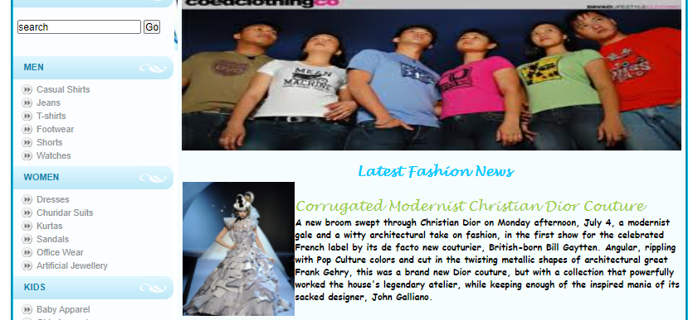
Online Shopping
Presented by Submitted to
Amarjit Y Mr. Jayant Kumar A Rathod
Ranjan Kumar
B.E. (Third Year)

Slide 2
What is Online Shopping?
The online selling of or enabling
the sale of products or services to
consumers.

Slide 3

How did Online Shopping come about?
Online shopping emerged with the development of the internet.
Entrepreneurs saw the potential in online shopping and sprung at the chance to make virtual storefronts, so that consumers could shop without leaving their homes.

Slide 4

Risks & Disadvantages of Online Shopping
Fraud- Do you know the Company?
Security- Is your credit card safe?
Privacy- Is your information being sold?
Shipping- Are you getting the correct product at the requested time?
Difficulty- Do you know how to shop online?

Slide 5
Consumer Benefits
Convenience
-Geographic
-Store hours
-Ease of transaction
-Quick and efficient shopping process
Information
-Quick location of items
-Easy price/attribute comparisons

Slide 6
Online Shopping VS. Traditional Shopping
Differences
-Cannot try or test product before purchase.
-Minimum human interaction if any.
-Cannot pay by cash.
-Shop anytime online.

Slide 7
Online Shopping VS. Traditional Shopping
Similarities
-Advertisement.
-Security.
-Convenience.

Slide 8
THANK YOU

